Slide 1

Customer Shopping Behavior Analysis
Uncovering insights from 3,900 purchases to guide strategic business decisions.

Slide 2

Dataset Summary
Key Features
Customer demographics (Age, Gender, Location, Subscription)
Purchase details (Item, Category, Amount, Season, Size, Color)
Shopping behavior (Discount, Promo, Previous Purchases, Frequency, Review, Shipping)
Data Snapshot
3,900
Rows
18
Columns
37
Missing values in Review Rating

Slide 3

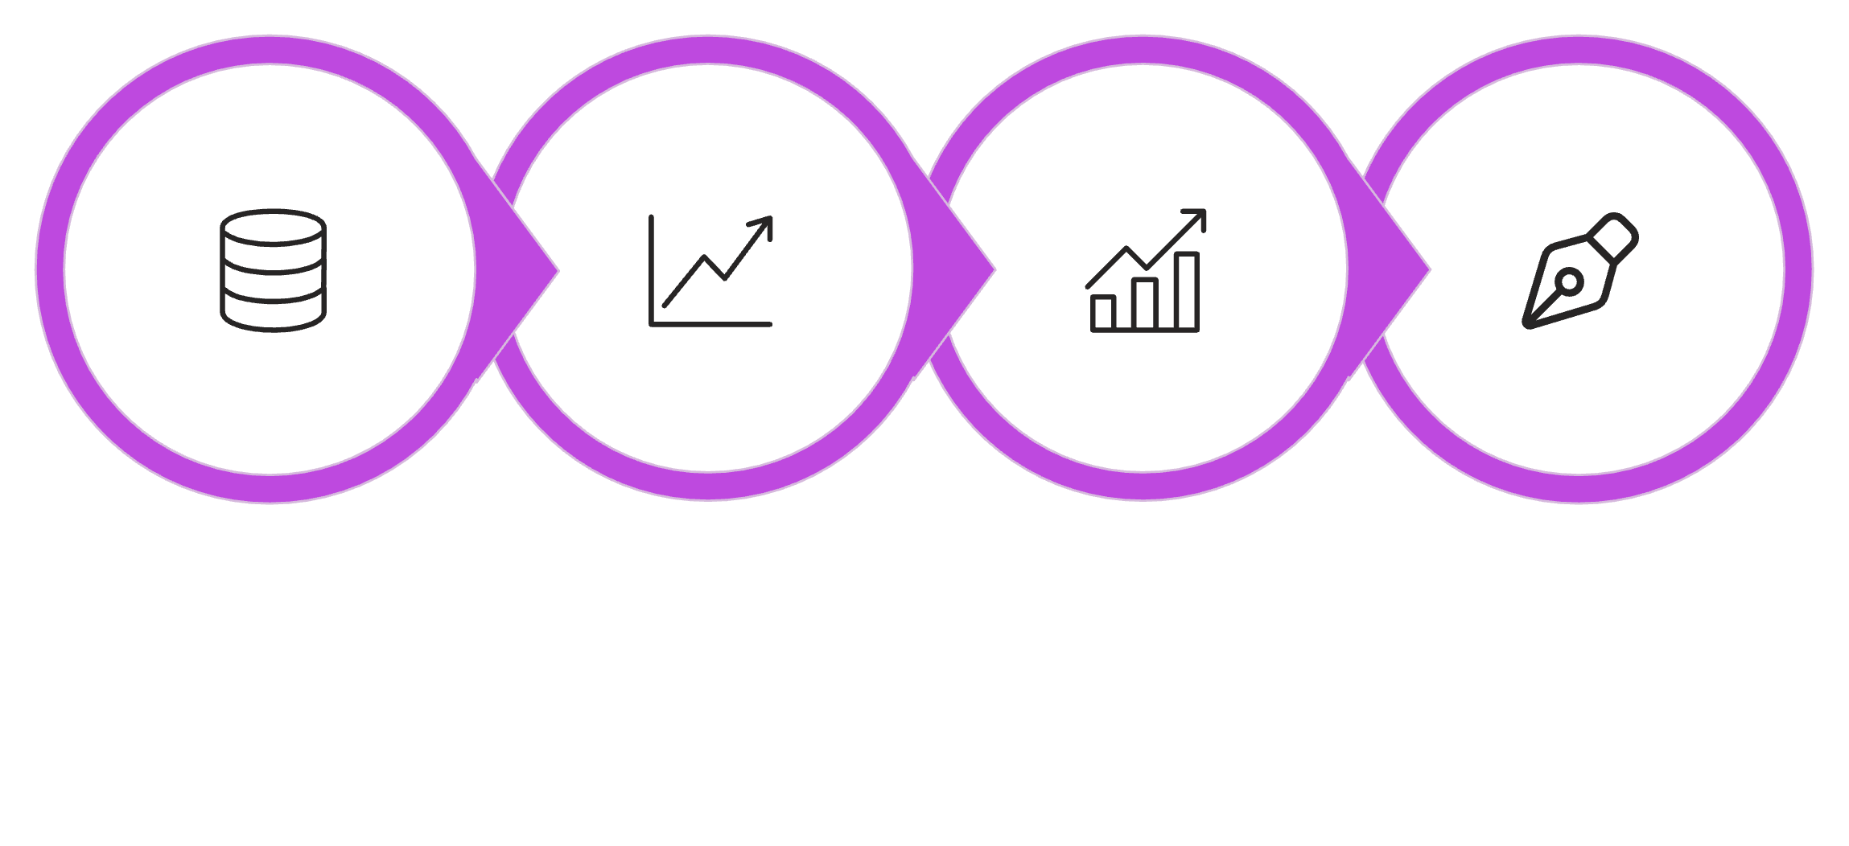

Exploratory Data Analysis (Python)
Initial Exploration
Missing Data Handling
Column Standardization
Data Loading
Data preparation and cleaning in Python for robust analysis.

Slide 4
Data Analysis (SQL)
Structured analysis in PostgreSQL to answer key business questions.
Revenue by Gender
High-Spending Discount Users
Female: $75,191
839 customers spent above average with discounts.
Male: $157,890
Top 5 Products by Rating
Shipping Type Comparison
Gloves (3.86), Sandals (3.84), Boots (3.82), Hat (3.80), Skirt (3.78).
Standard: $58.46
Express: $60.48

Slide 5
SQL Insights Continued
1,053
2,847
50%
3,116
Subscribers
Non-Subscribers
Discount-Dependent
Loyal Customers
customers generated $62,645 revenue.
customers generated $170,436 revenue.
Hat is the top product at 50%. Others: Sneakers (49.66%), Coat (49.07%), Sweater (48.17%), Pants (47.37%).
Highest customer segment.
701
83
958
Returning Customers
New Customers
Repeat Buyers
Segment size.
Segment size.
are also subscribers. 2,518 repeat buyers are not subscribers.

Slide 6

Top Products & Revenue by Age
Top 3 Products per Category
Revenue by Age Group
Young Adult: $62,143
Middle-aged: $59,197
Adult: $55,978
Senior: $55,763
Accessories: Jewelry, Sunglasses, Belt
Clothing: Blouse, Pants, Shirt
Footwear: Sandals, Shoes, Sneakers
Outerwear: Jacket, Coat

Slide 7
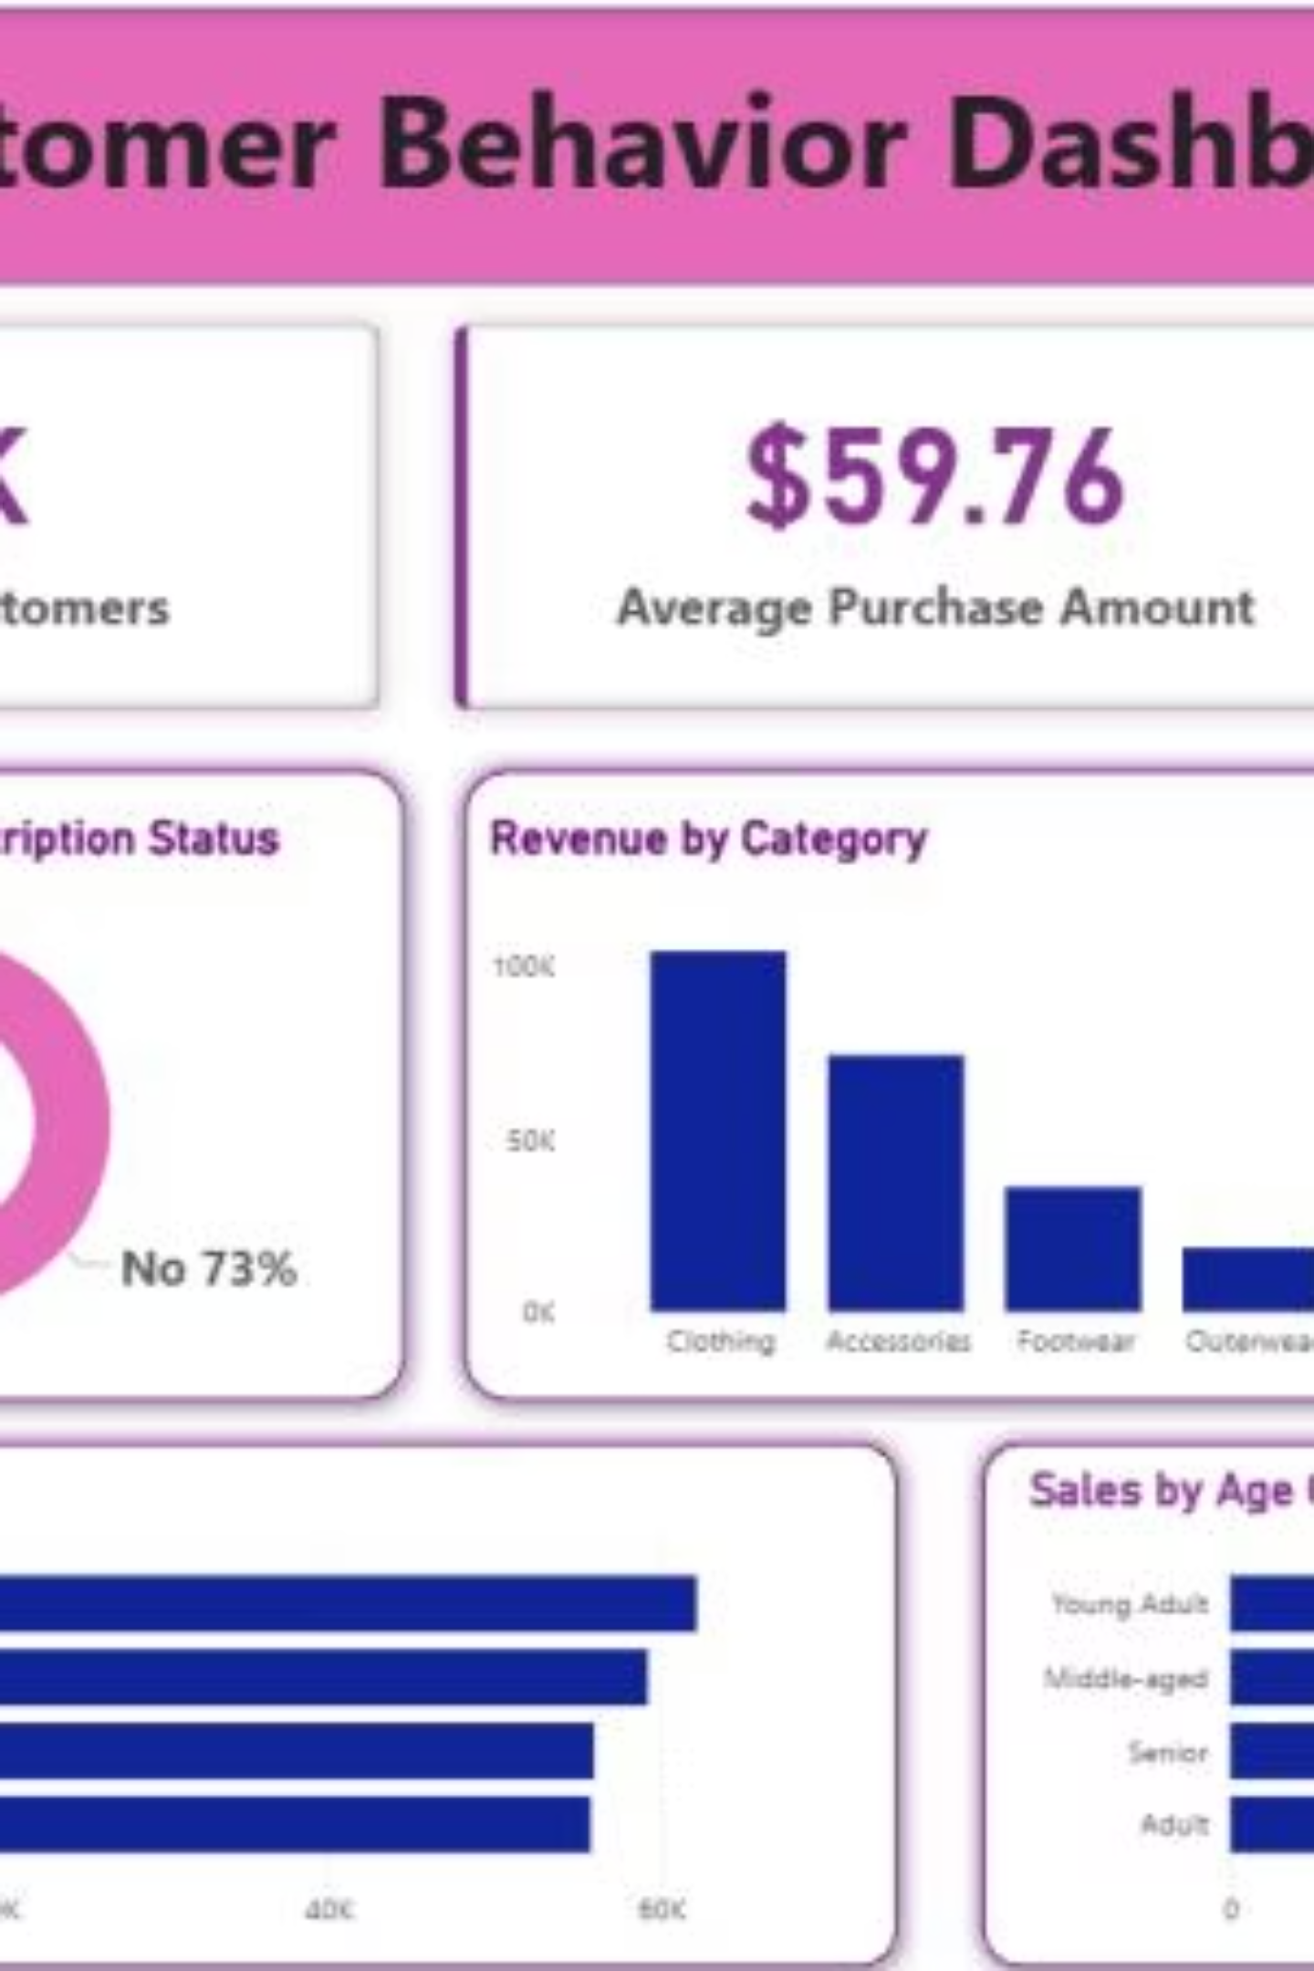
Power BI Dashboard
Interactive dashboard for visual insights.

Slide 8
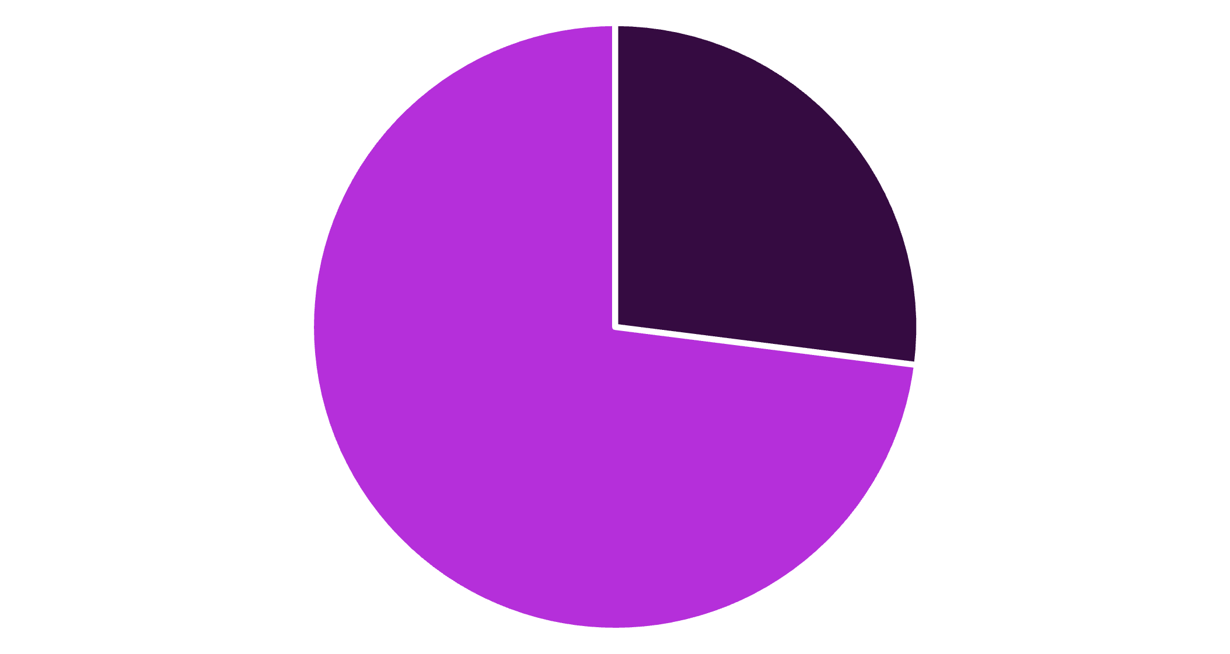
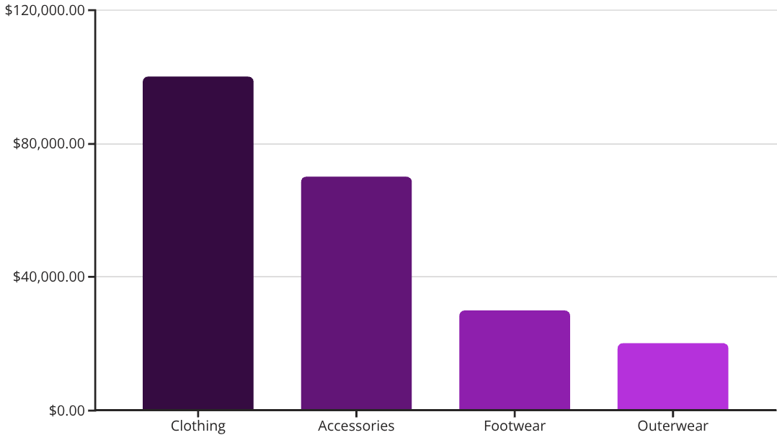
Dashboard Key Metrics
3.9K
$59.76
3.75
Customers
Avg. Purchase
Avg. Review
Yes
No

Slide 9
Business Recommendations
Boost Subscriptions
Promote exclusive benefits for subscribers.
Customer Loyalty Programs
Reward repeat buyers to foster loyalty.
Review Discount Policy
Balance sales boosts with margin control.
Product Positioning
Highlight top-rated and best-selling products.
Targeted Marketing
Focus on high-revenue age groups and express-shipping users.

